Slide 1
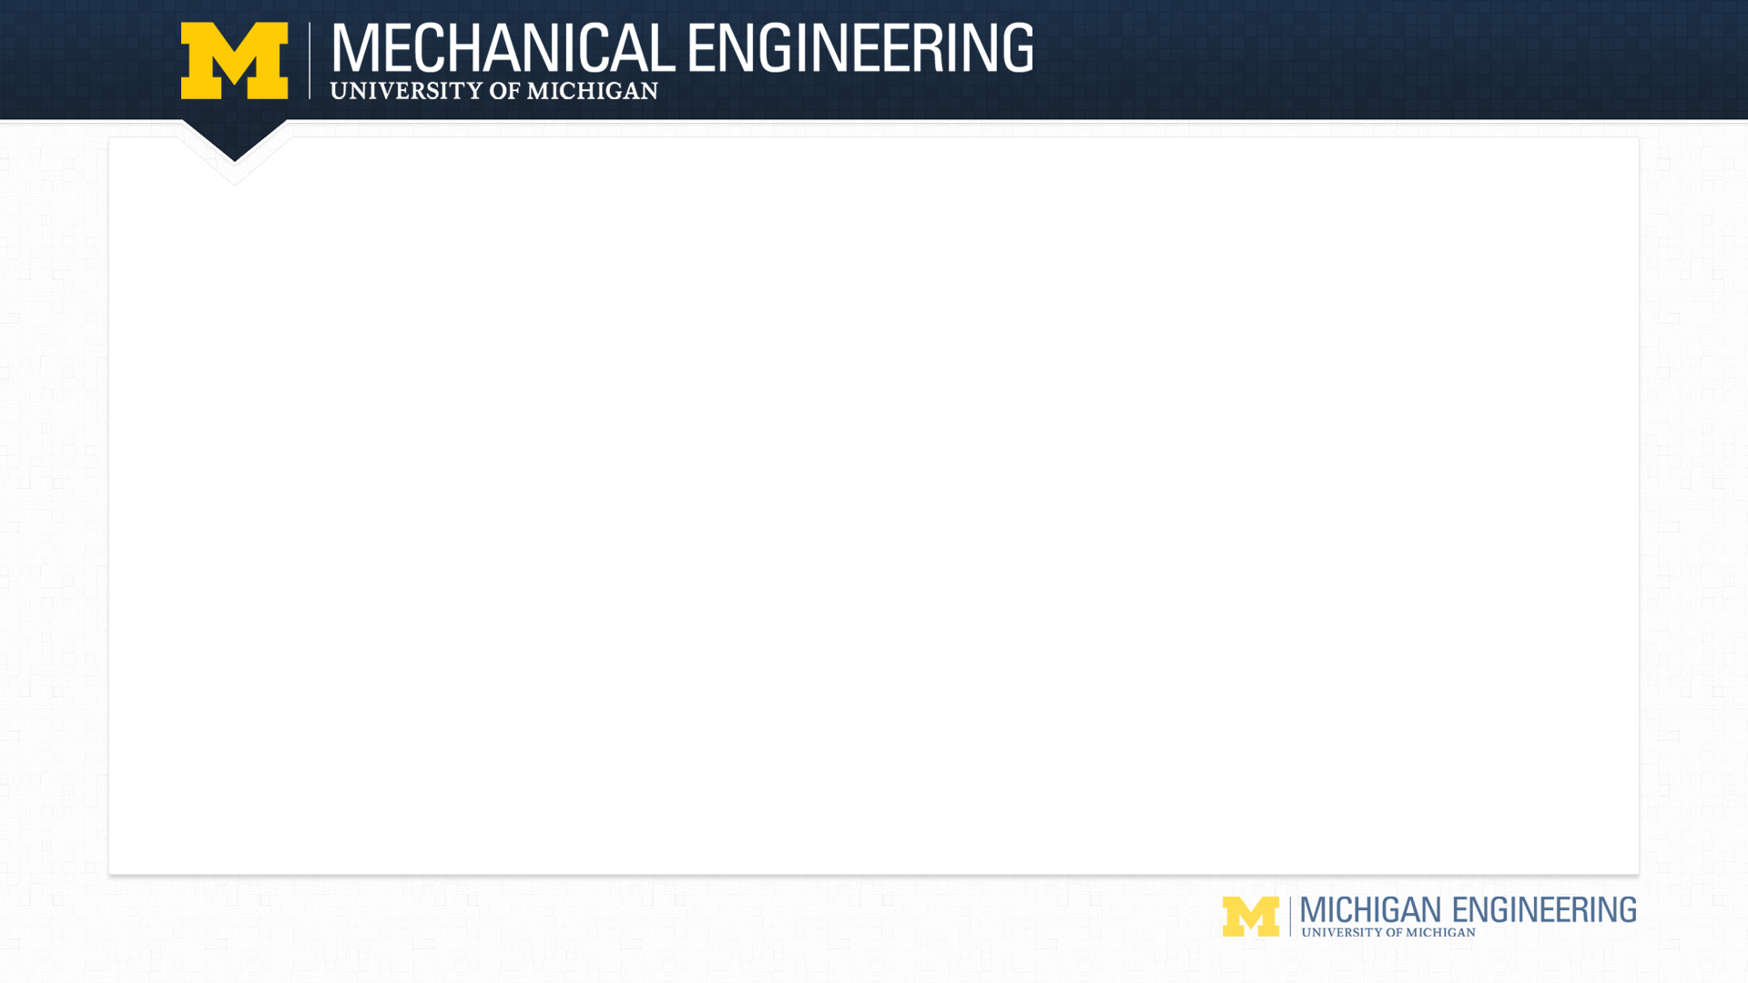
PLC Training Fall 2017
Christopher Shu (Mechanical subteam) shuchris@umich.edu
Gibin Joe Zachariah (Controls subteam) gibinzac@umich.edu

Slide 2
Outline
Introductions
Chris Shu: CNC part centering
Gibin Zachariah: Camera
Introduction to PLCs (from other training presentations)
Background
Hardware and testbed
Software and ladder logic
Example
Testbed

Slide 3
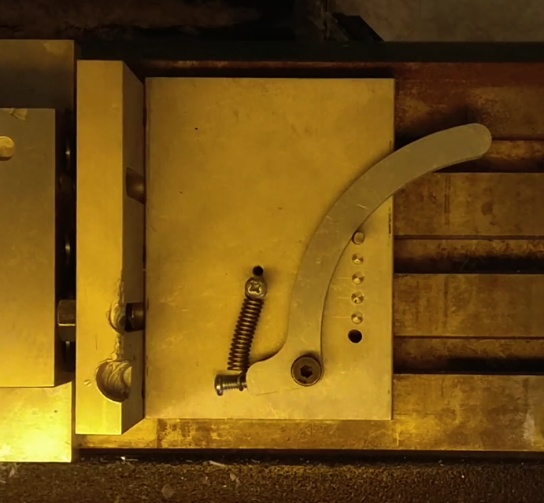
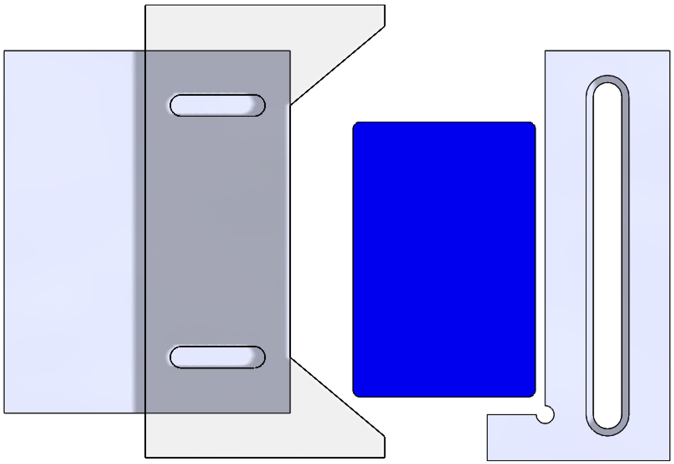
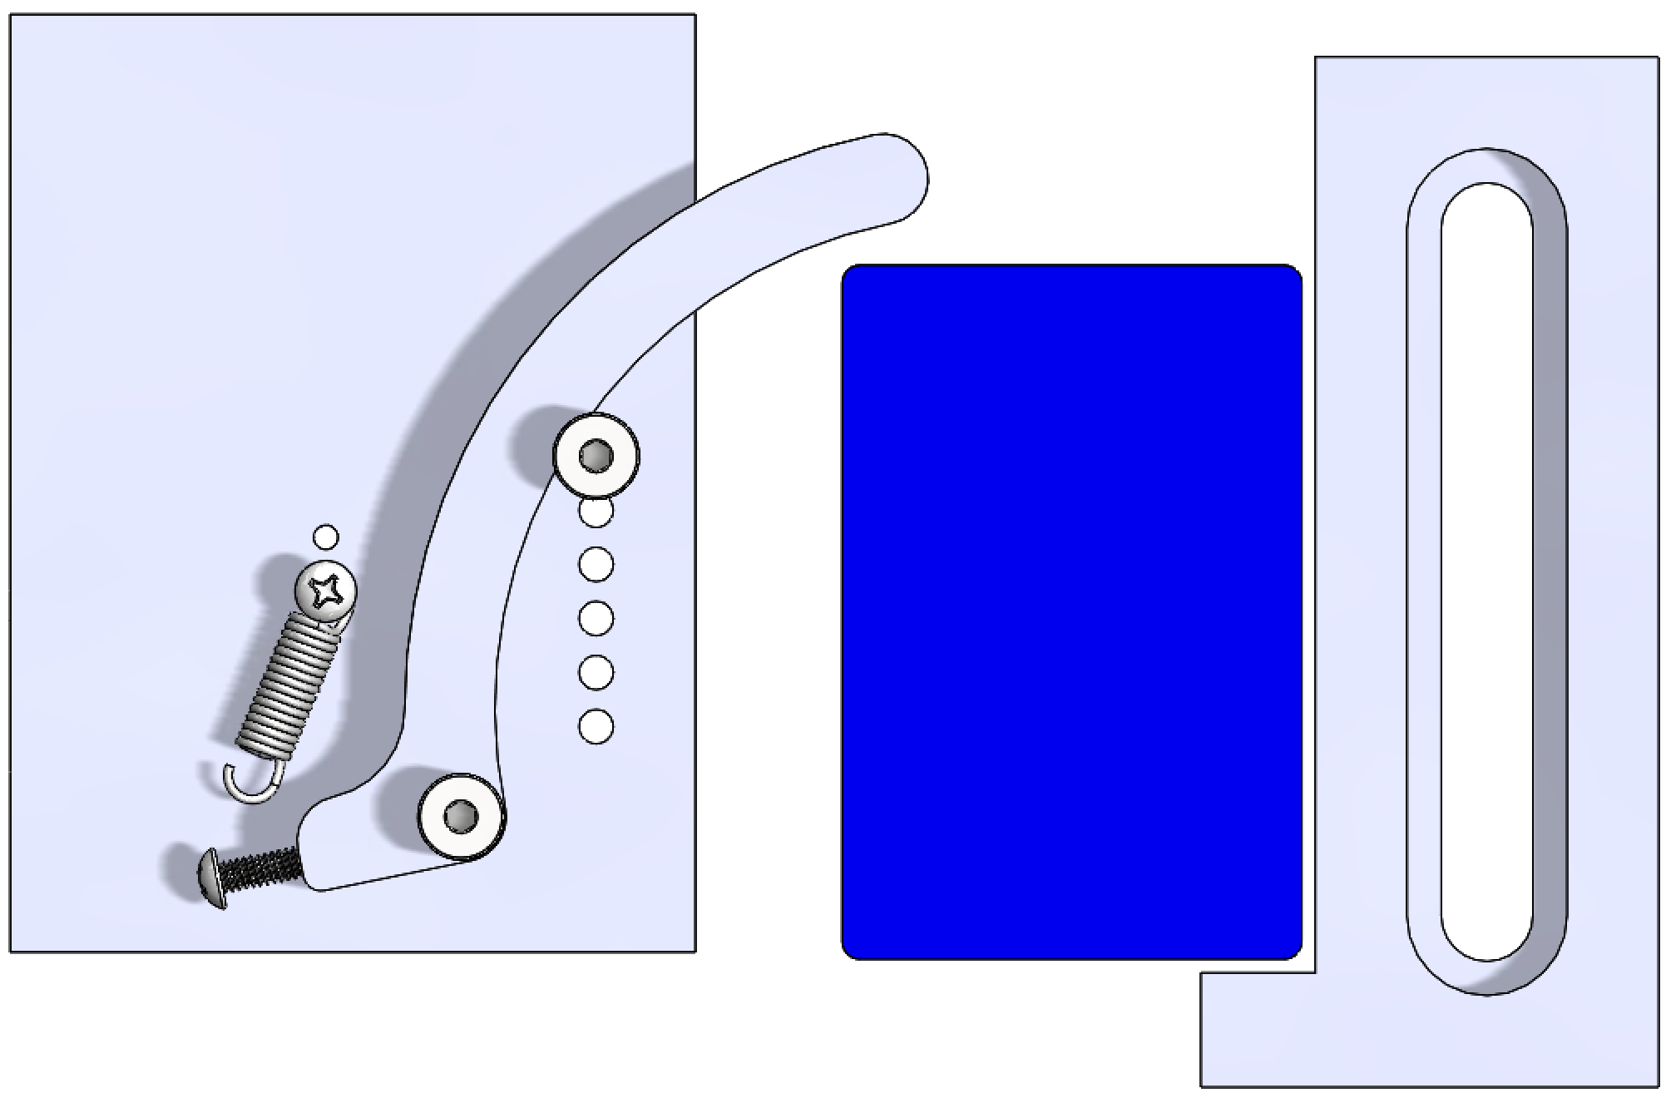
CNC Part Centering
Goal was to design a method of holding different sized workpieces accounting for robot placement inaccuracies
Previous method centered part to undefined origin, secured it by two line contacts, and didn’t work for thicker workpieces
New design centers to known vise origin, secures by surface contact, and is adjustable for different sized workpieces

Slide 4
Camera
Used for quality control.
Defects are identified through image processing and are sent out without doing further processes.
Increases efficiency and reduces wastage of machine time.

Slide 5
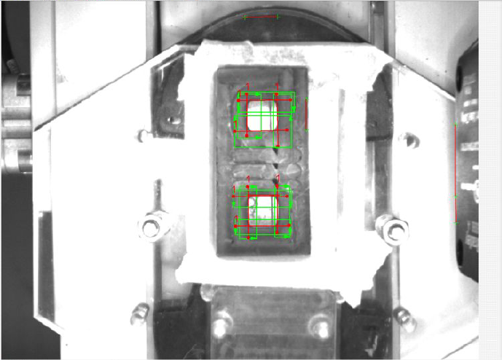

Slide 6
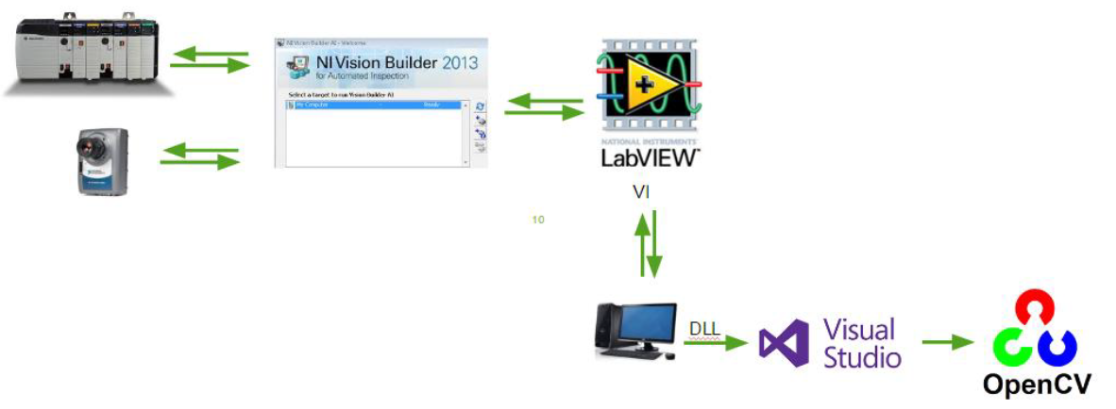

Slide 7
PLCs: Background
Programmable Logic Controllers (PLCs) were developed due to the need of reconfiguration in automotive manufacturing, which relied on wiring and relay-based control systems
PLCs are used in the automotive, petroleum, and chemical industry, CNC manufacturing, others
There are many brands of PLCs. They are programmed with languages standardized in IEC 61131-3. One of those languages is ladder logic.
Automation control system diagram:
Input Sensors
Programmable Logic
Controller
Output Actuators
Measurement
Resultant
Actions
Process
Notes:
International Electrotechnical Commission.

Slide 8
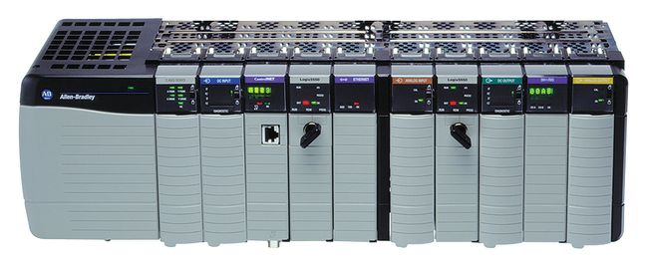
PLCs: Hardware and testbed
CPU: Main control center that evaluates the logic and changes outputs every 5 to 50 ms
Power supply: Supplies power for the CPU and I/O sections
Programming interface device: Computer used to write a ladder program that can download (send to PLC), upload (read from PLC) or go online, and has a monitor. Studio 5000 is the application software for programming the PLCs we use
I/O modules: Work with voltages higher than the CPU can handle. These modules “isolate” the PLC and protect its circuits.
Power supply
Slot [0] : CPU
Slots [1:n] : I/O section

Slide 9
PLCs: Hardware and testbed
Process
Example diagram of a manufacturing plant
PLC
Parts
bin
Processor
Input/Output
Modules
Outputs:
Motors
Solenoids
Pneumatic actuators
Robot
arm
CNC
drill
Inputs:
Limit switches
Proximity
RFID sensors
Conveyor
Pick-up
point
Programming Terminal
Notes:
HARDWARE: “Loops” (conveyors), “Cells” (cages for robots), “Hold Stops?” (pallet stoppers), “Diverter” (between conveyors, directing pallet flow), CNCs, Cameras, RFID sensors, RF modules

Slide 10
Software and ladder logic
We use Studio 5000® Logix Designer from Rockwell
Ladder logic is the first/most popular PLC programming language (functional block is another)
The Ladder Diagram (LD) programming language originated from the graphical representation used to design an electrical control system
Control decisions were made using relays
After a while relays were replaced by logic circuits
Logic gates used to make control decisions
Finally, CPUs replaced logic circuits
Relay Logic representation (or LD) developed to make program creation and maintenance easier (control decisions accomplished through programming)
Computer based graphical representation of wiring diagrams that was easy to understand
Reduced training and support cost
CPU

Slide 11
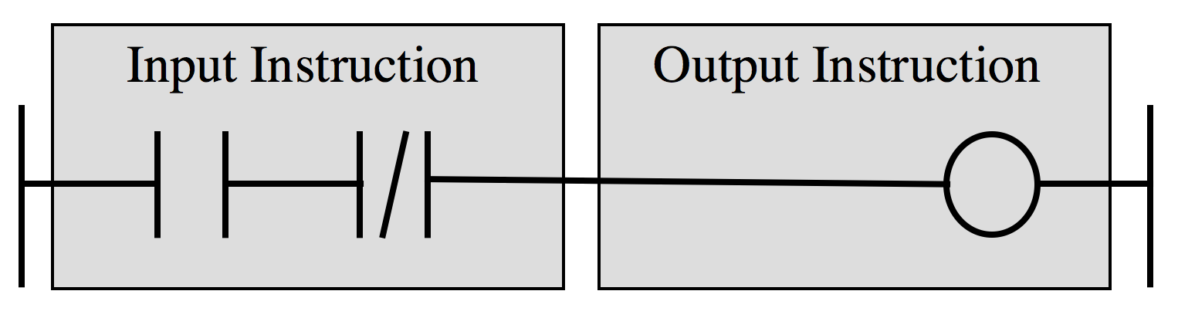
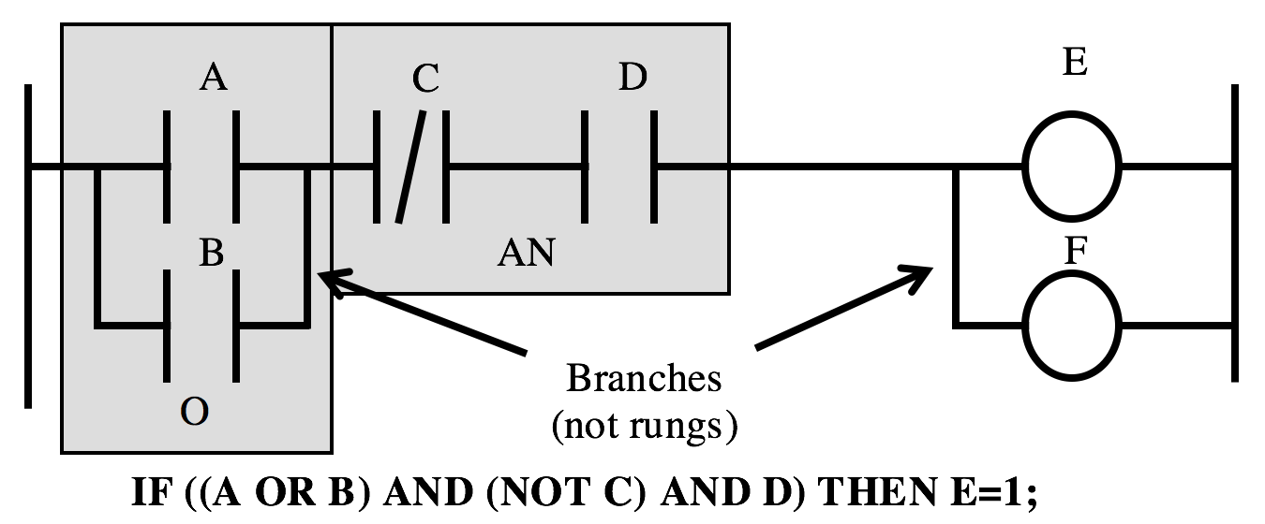
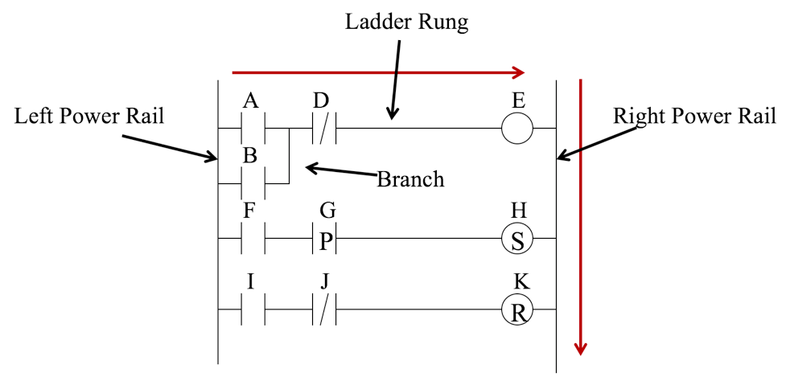
Software and ladder logic
A rung of ladder diagram code can contain input and output instructions
Input contacts serve as conditional statements for executing output coils (commands)
Ladder logic execution
Rungs of ladder diagram are solved from left to right and top to bottom
Branches within rungs are solved top left to bottom right
Timers and counters are other operations used to delay operations

Slide 12
Additional references
See shared network drive for references
Video by Ziyan Zhang F16 (61mins):
02_MDP > 03_Control > Training Materials > PLC Training.mp4
02_MDP > 03_Control > Training Materials > PLC Basic Training.pptx
PPT on ladder logic basics
02_MDP > 02_Mechanical > Winter 2017 > Training_2017 > PLC Training > PLC Programming.pptx
PPT on ladder logic by Rockwell Automation
02_MDP > 02_Mechanical > Winter 2017 > Training_2017 > PLC Training > PLC Ladder Diagram.pptx
PDF compilation of all material by Chris Shu and Adrian Pinto W17:
02_MDP > 02_Mechanical > Winter 2017 > Training_2017 > PLC Training > Compilation of PLC Training Material and Examples.pdf

Slide 13
Example
Introduction to PLCs and Ladder Logic concepts: relay-based circuit example and ladder logic origins

